Slide 1


Reproducing Spectral Reflectances From Tristimulus Colours
Hisanari Otsu^{1,3} Masafumi Yamamoto^{2,3} Toshiya Hachisuka³
¹Karlsruhe Institute of Technology ²DeNA Co., Ltd. ³The University of Tokyo
Notes:
Thank you for the introduction. I’ll talk on the research titled with, “Reproducing spectral reflectances from tristimulus colors”.

Slide 2

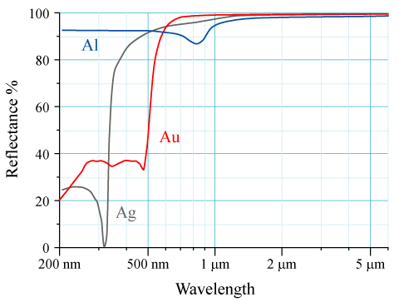
[https://en.wikipedia.org/wiki/Reflectance]
Notes:
Color of an object is characterized by the reflectance, the ratio of the energy of the light, reflected on the surface. Especially, the spectral reflectance is defined as reflectance values as a function of wavelength.
In order to achieve physically-accurate light transport, we need to simulate light transport with multiple wavelengths. This way of light transport simulation is called spectral rendering.

Slide 3
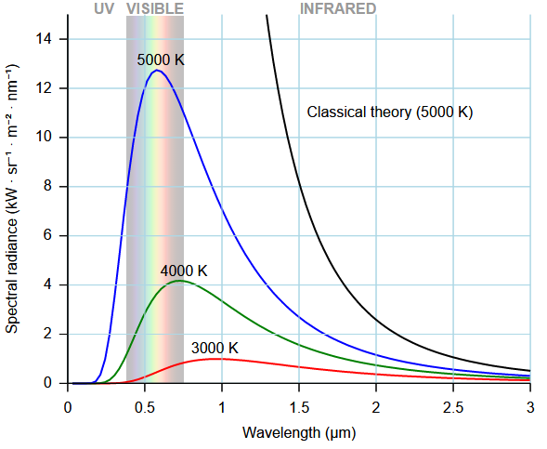
Spectral energy of black-body radiation
[https://en.wikipedia.org/wiki/Black-body_radiation]
Notes:
Spectral rendering enables us to use physically-accurate models, such as wavelength-dependent light sources,

Slide 4

[LuxRender]
Notes:
… or makes it possible to simulate wavelength-dependent phenomena like dispersion.

Slide 5
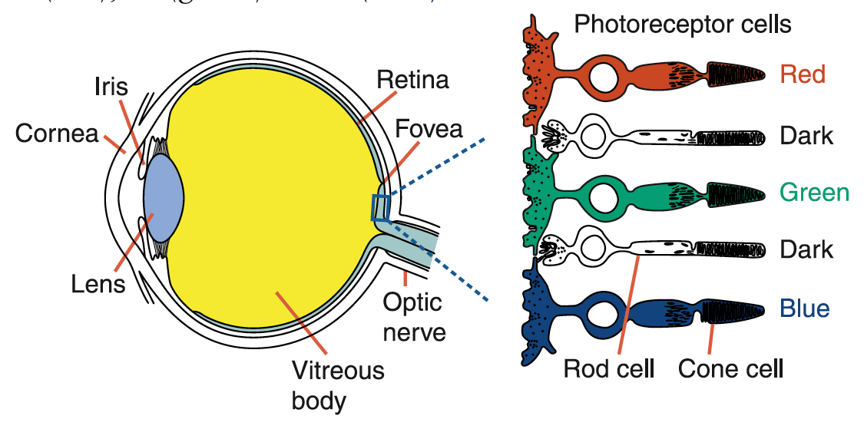
[http://www2.cudo.jp/wp/?page_id=1936]
Notes:
On the other hand, it is known that human eye can perceive color chromaticity by photoreceptor cells, called the cone cells. The cone cells are categorized into three kinds. Each of cells are responsible for the different ranges of spectra roughly corresponding to the ranges of short, medium, and long wavelengths respectively. This explain why human vision system is said to be trichromatic.
Given this fact, instead of simulation per wavelength, we often use tristimulus rendering where we simulate light transport only with tristimulus colors, for instance, RGB colors.

Slide 6
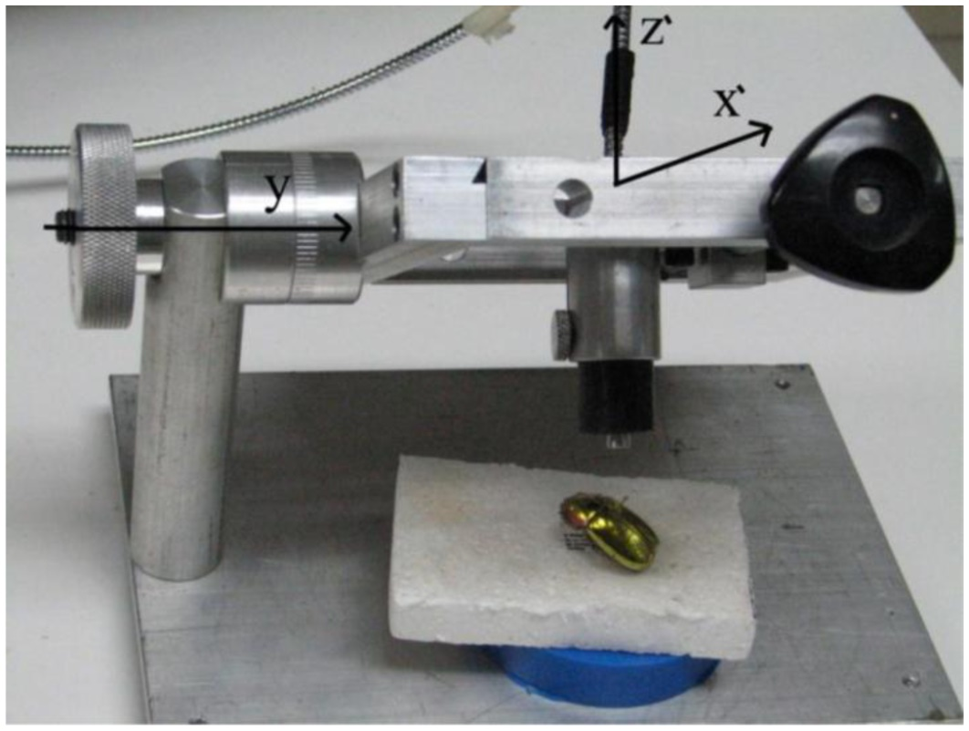
Obtaining spectral reflectance
Difficulty: special equipment, measurement cost
[https://cornerofthecabinet.files.wordpress.com/2015/01/figure2.jpeg]
Notes:
In spectral rendering, ideally, we want to measure the spectral reflectance to characterize the scene surface. Such an approach, however, can be time-consuming and expensive because it needs special equipment. This difficulty is more significant if the measured materials are represented by textures.

Slide 7
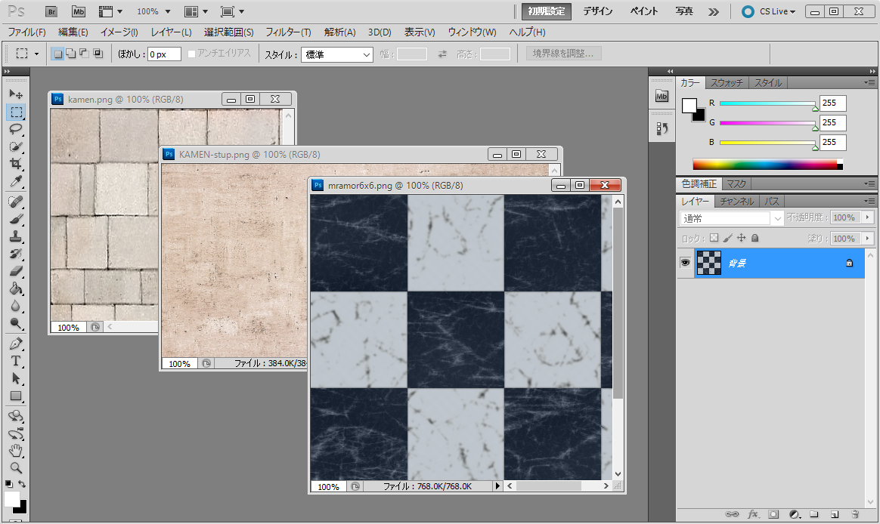
Obtaining spectral reflectance
Textures are made with tristimulus colors
Notes:
Therefore, in the standard workflow of contents creation tools, or commonly available measuring devices, only supports the workflow with tristimulus colors.

Slide 8
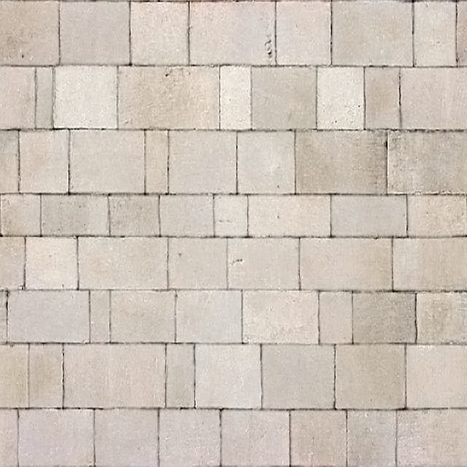


Problem definition
Converting tristimulus color to spectrum
Reflectance
Wavelength
Material with tristimulus colors
Spectral reflectance
Notes:
The spectral renderer, however, inputs spectral data instead of the tristimulus colors. So we need to convert materials with tristimulus colors to the spectral format. In this paper, we aim to directly use tristimulus colors as an input to the spectral rendering system.

Slide 9
Metamerism
Tristimulus color
…
An RGB color corresponds to several spectra
Notes:
This requirement leads to a difficulty of getting a spectrum from a tristimulus color. This problem is called the metamerism, the concept that one tristimulus color [click] corresponds to the multiple spectra.
Due to the metamerism, the problem of obtaining a spectrum from a tristimulus color becomes ill-posed and we need to select one spectra among the multiple choices.

Slide 10
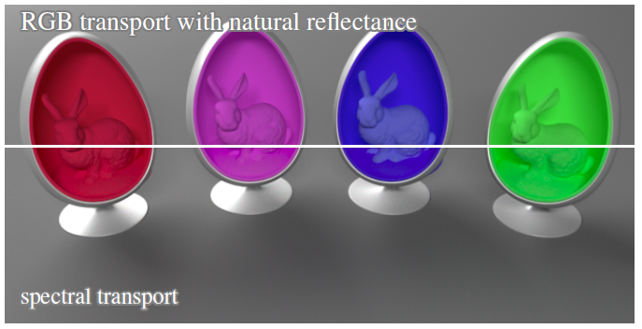
Related work
Approaches in computer graphics
Uses the heuristic that natural spectra is smooth
[Smits 1999]
[Meng et al. 2015]
Notes:
Existing approaches in computer graphics attempt to solve this problem by solving an optimization problem based on the heuristic that natural spectra is smooth.

Slide 11


Smits’s approach [Smits 1999]
$$c$$
Tristimulus color
Reflectance
Reflectance
…
Wavelength
Wavelength
Discretized spectrum ${\{S}_{i}\}$
Notes:
For instance, Smits’s approach represents a spectrum as a discretized histograms, and tries to pick one of the histograms satisfying the given constraints by solving an optimization.

Slide 12


Smits’s approach [Smits 1999]
Optimize spectrum to be smooth
Natural reflectance spectra tend to be smooth [Maloney 1986]
smoothness
Minimize $\sum_{i}{\left|S_{i}−S_{i+1}\right|}$
constrained to $M_{S→RGB}S=c$
Recovery of
original tristimulus color
Notes:
The optimization problem is formulated to minimize the smoothness of the spectrum while retaining the recovery of the original tristimulus color. This means the reconstructed spectrum can be converted to the original tristimulus color. Smoothness is represented by minimizing the sum of the difference between the adjacent bins of the discretized spectrum.

Slide 13
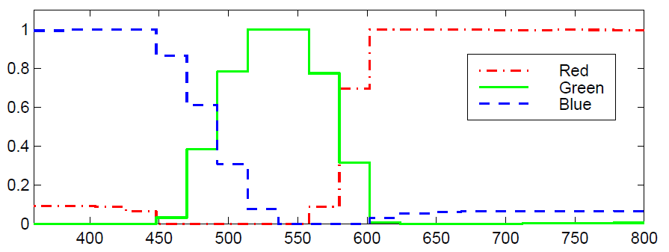
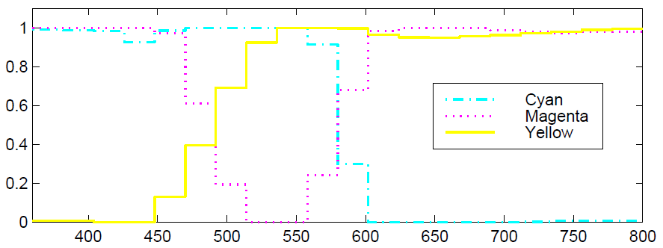

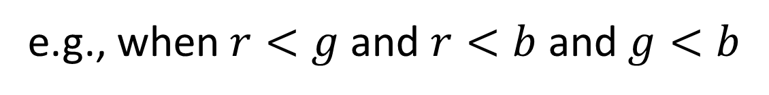
Interpolation [Smits 1999]
In runtime, spectrum is reconstructed by two of the precomputed spectra using the linearity of colors
e.g., when $r<g$ and $r<b$ and $g<b$
$${S_{recon}=S}_{∎}r+S_{∎}(g−r)+S_{∎}(b−g)$$
white
cyan
blue
$S_{∎}:$Precomputed reconstructed spectra
Notes:
In runtime, instead of using optimization for every colors, the spectrum is reconstructed using two of the precomputed spectra, utilizing the linearity of the colors. The interpolation is designed to utilize the property that the white spectra is constant. The approach by Meng and colleagues extended the interpolation to use multiple points in the chromaticity diagram.

Slide 14
Related work
Approaches in computer graphics
Uses the heuristic that natural spectra is smooth
Ignores actual shapes of measured spectra
[Smits 1999]
[Meng et al. 2015]
Notes:
These approaches, however, [click] has a little connection to the actual shape of the spectrum, except for the smoothness. [click]

Slide 15
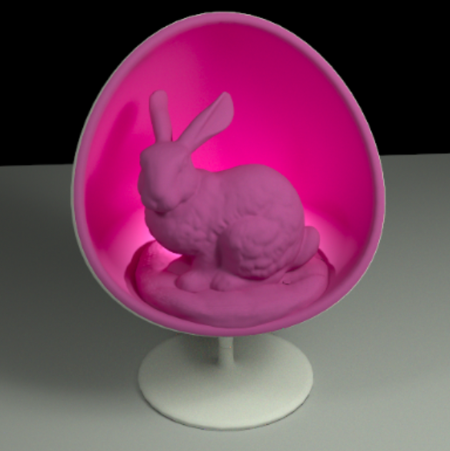
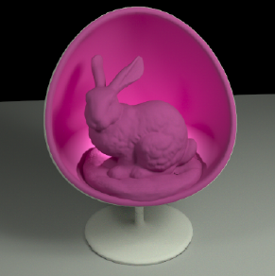
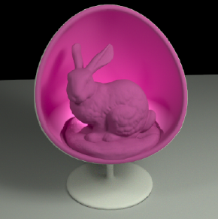

Color shift due to interreflection
Reference
Smits
Meng et al.
Ours
Color shift
Notes:
This difference in shape of spectra can be visible as a color shift [click] in the rendered images, because the shape of the spectrum are deviated due to the interreflection.

Slide 16
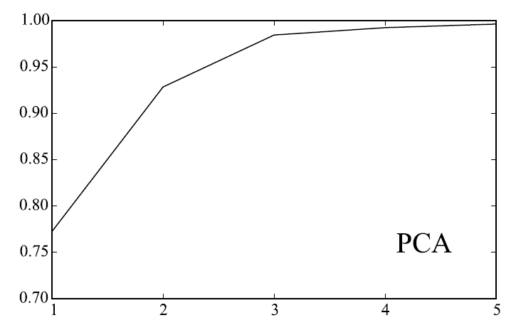
Idea
Observation from color science field
Measured spectral reflectance can be accurately reproduced with a few principal components using principal component analysis (PCA) [Cohen 1964] [Fairman & Brill 2004]
Ratio of explained variance
# of principal components
Notes:
In the proposed approach, we will solve this problem using a data-driven approach, based on the observation from the color science field that, measured spectra can be accurately reproduced with a few basic functions using principal component analysis.
The right figure shows the cumulative sum of the explained variance of the input data, which shows the relationship between the number of principal components and a portion of the variation of the data explained using the number of principal components. In PCA, the accumulated contribution is utilized to assess how much of the information is kept with a given number of components. And, this figure indicates only three components can explain more than 95% of the data.

Slide 17
Contribution
Data-driven spectrum reconstruction from tristimulus colors for rendering
Reformulates relationship between reflectance spectra and tristimulus colors with PCA
Greedy hierarchical clustering to minimize reconstruction errors
Simple runtime algorithm
Notes:
To do this, we first compute the low-dimensional representation of the measured spectra using PCA, and reconstruct the spectrum from a tristimulus color based on that representation. Also, we incorporated greedy hierarchical clustering in order to improve the accuracy of the reconstruction. The final run-time reconstruction algorithm is simple and fast and suitable to use in rendering. Our approach does not require neither optimization or interpolation in runtime and can be written with several conditional branches and matrix multiplications.

Slide 18
Design criteria
Reproduction of spectra
Reconstructed spectra should match the measured spectra as well as possible
Recovery of tristimulus colors
Reconstructed spectrum should represent the input color
Fast runtime reconstruction
Runtime computation should be not much
Notes:
We determined three design criteria for the goal.
First is the reproduction of spectra, which means the reconstructed spectra should match the measured spectra in terms of its shape. This is an important to avoid the color-shift when we consider interreflections.
Second is the recovery of tristimulus colors, which means the reconstructed spectra should represent the input tristimulus color. This property is important because in spectral rendering the calculated spectra must be converted again to a tristimulus color when it is converted to the image.
Third is the fast runtime reconstruction.

Slide 19
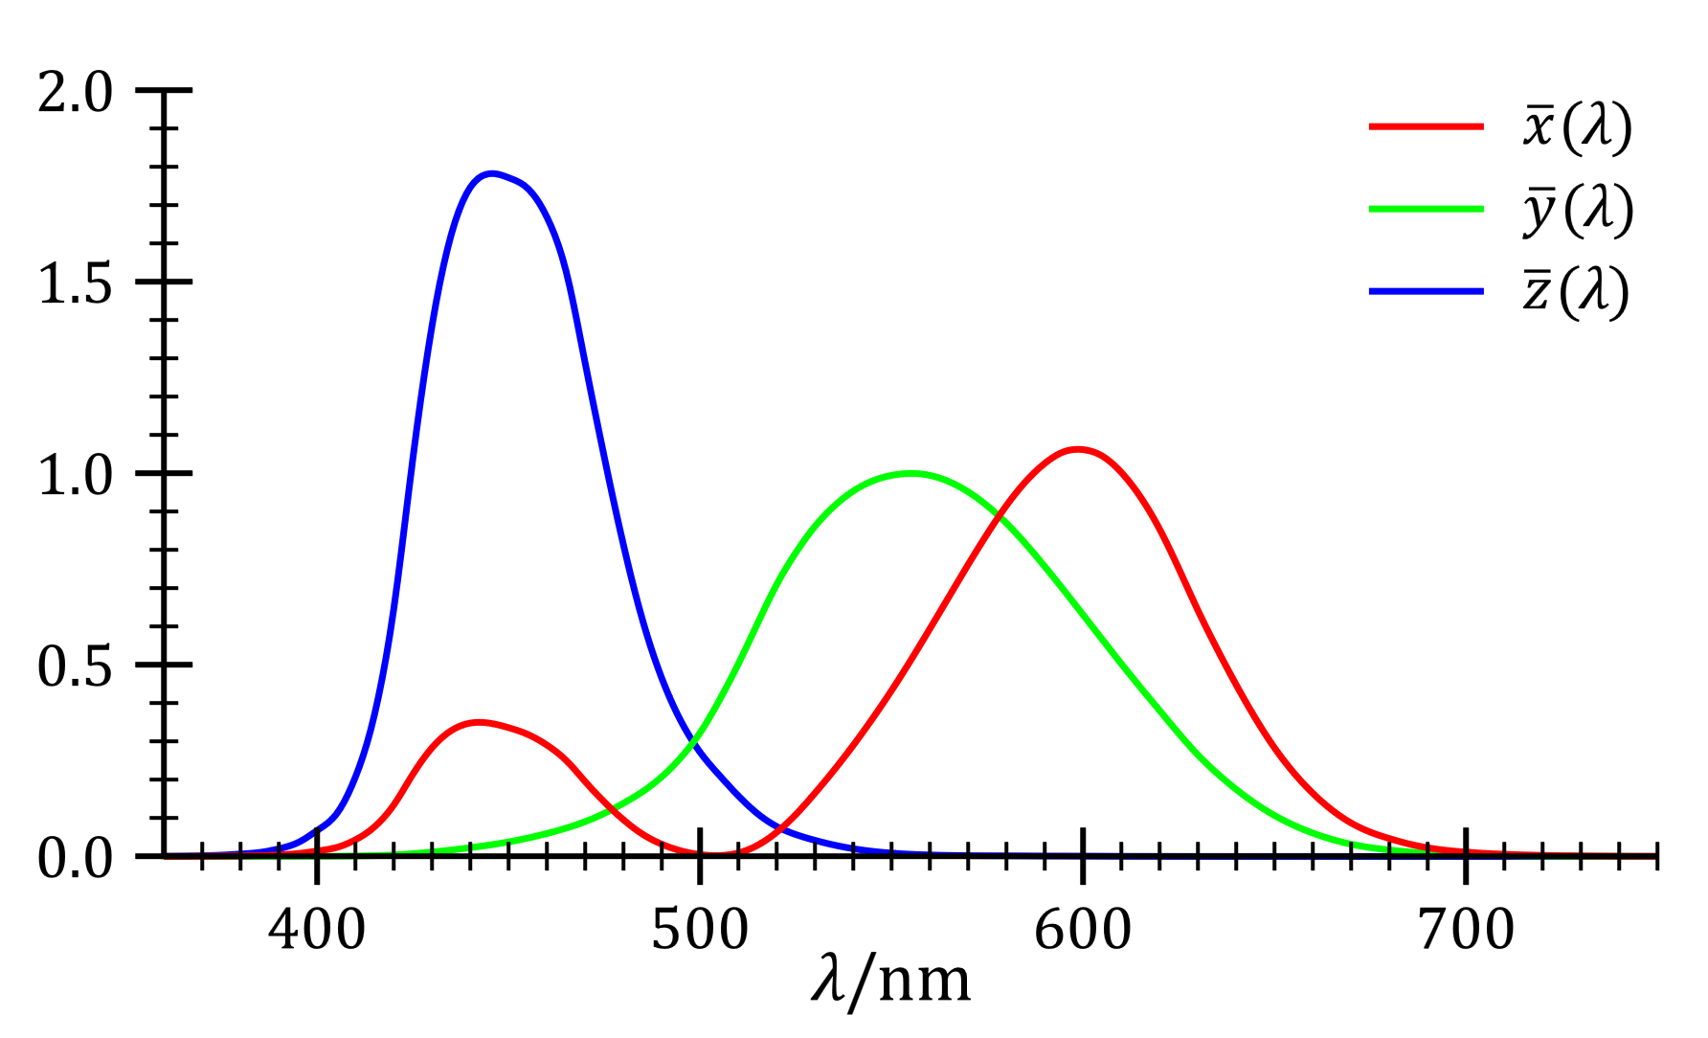


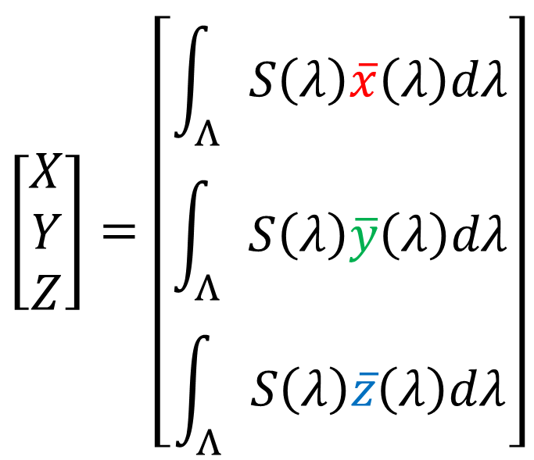
Tristimulus color
Spectrum $S(λ)$ to tristimulus values ${\left[X Y Z\right]}^{T}$
$$\left[\begin{matrix}X \\ Y \\ Z\end{matrix}\right]=\left[\begin{matrix}\int_{Λ}{S\left(λ\right)\overline{x}\left(λ\right)dλ} \\ \int_{Λ}{S\left(λ\right)\overline{y}\left(λ\right)dλ} \\ \int_{Λ}{S\left(λ\right)\overline{z}\left(λ\right)dλ}\end{matrix}\right]$$
Color matching functions
Visible wavelength $Λ$
Notes:
I will explain the method in detail. Given a spectrum S, the tristimulus values XYZ can be converted by integrating spectrum multiplied by the color matching functions, over the visible wavelength. The color matching functions are standardized and we used the values in CIE 1931 standard observer.

Slide 20
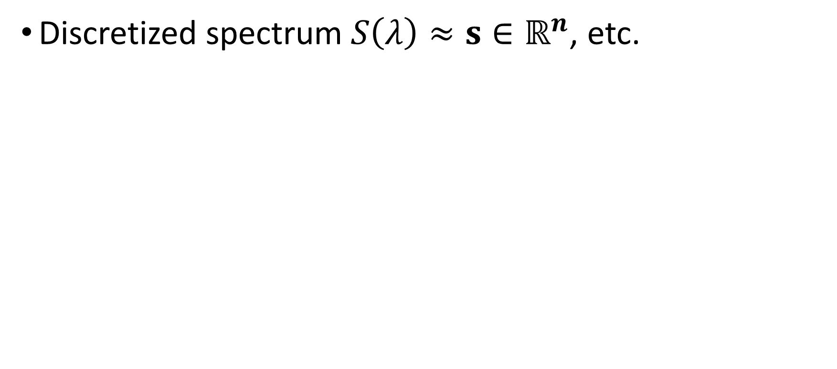
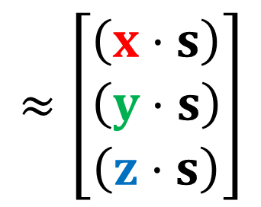

Tristimulus color
Discretized spectrum$S\left(λ\right)≈s∈ℝ^{n}$, etc.
$$\left[\begin{matrix}X \\ Y \\ Z\end{matrix}\right]=\left[\begin{matrix}\int_{Λ}{S\left(λ\right)\overline{x}\left(λ\right)dλ} \\ \int_{Λ}{S\left(λ\right)\overline{y}\left(λ\right)dλ} \\ \int_{Λ}{S\left(λ\right)\overline{z}\left(λ\right)dλ}\end{matrix}\right]$$
$$≈\left[\begin{matrix}\left(x⋅s\right) \\ \left(y⋅s\right) \\ \left(z⋅s\right)\end{matrix}\right]$$
Notes:
Next we discretize the spectrum. In the following discussion, we will denote the discretized spectrum with bold characters.

Slide 21
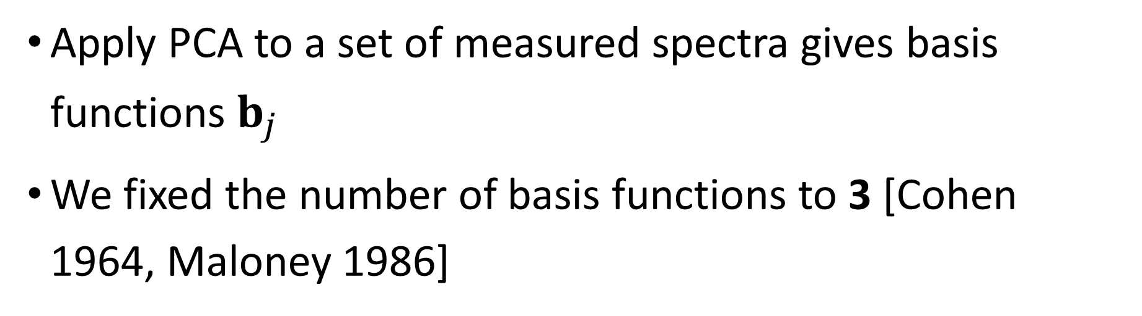
Reconstruction via PCA
Apply PCA to a set of measured spectra gives basis functions $b_{j}$
We fixed the number of basis functions to 3 [Cohen 1964, Maloney 1986]
$$s≈\hat{s}=w_{1}b_{1}+w_{2}b_{2}+w_{3}b_{3}$$
Notes:
Given a set of measured spectra, we apply PCA and obtain the basis functions b_j. The spectrum can be represented by the weighted sum of the basis functions.
Here, we fixed the number of basis functions to three, based on the knowledge from color science field, as I mentioned. With this, we can represent the spectrum using the space of three weights.

Slide 22
Reconstruction via PCA
Apply PCA to a set of measured spectra gives basis functions $b_{j}$
We fixed the number of basis functions to 3 [Cohen 1964, Maloney 1986]
$$s≈\hat{s}=w_{1}b_{1}+w_{2}b_{2}+w_{3}b_{3}+μ$$
Average of measure spectra
Notes:
Actually, we apply PCA for the data offset by the average of measure spectra. Thus we need an average term to represent the spectrum, in addition to the weighted sum of the basis functions.

Slide 23
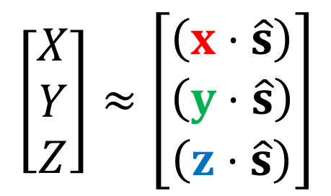
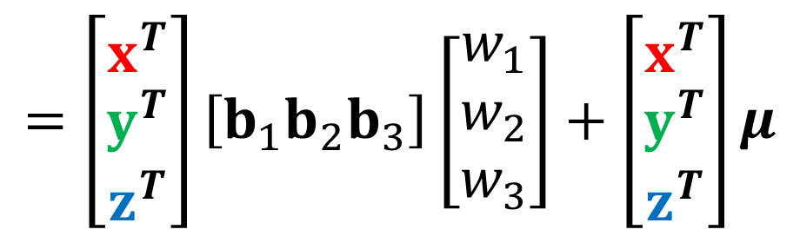
Reconstruction via PCA
$$\left[\begin{matrix}X \\ Y \\ Z\end{matrix}\right]≈\left[\begin{matrix}\left(x⋅\hat{s}\right) \\ \left(y⋅\hat{s}\right) \\ \left(z⋅\hat{s}\right)\end{matrix}\right]$$
$$=\left[\begin{matrix}x^{T} \\ y^{T} \\ z^{T}\end{matrix}\right]\left[b_{1}b_{2}b_{3}\right]\left[\begin{matrix}w_{1} \\ w_{2} \\ w_{3}\end{matrix}\right]+\left[\begin{matrix}x^{T} \\ y^{T} \\ z^{T}\end{matrix}\right]μ$$
Notes:
Therefore, combined with the conversion between the spectrum and the tristimulus values XYZ, we can get a linear equation according to the three weights.

Slide 24
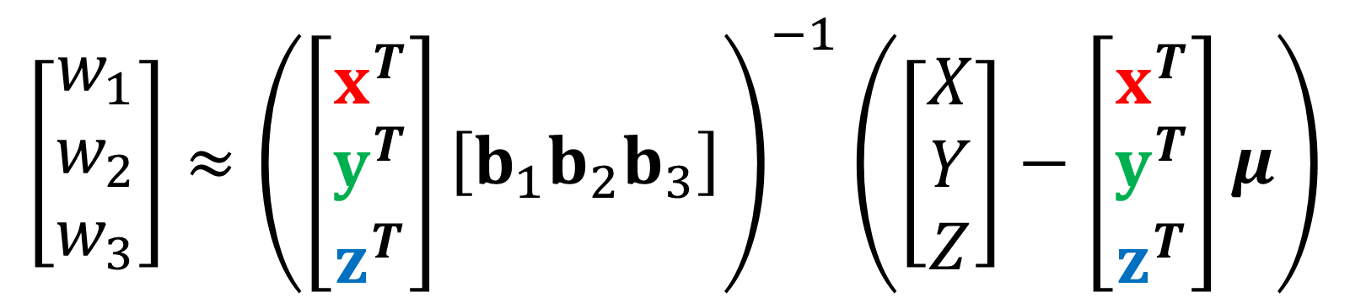

Reconstruction via PCA
$$\left[\begin{matrix}w_{1} \\ w_{2} \\ w_{3}\end{matrix}\right]≈{\left(\left[\begin{matrix}x^{T} \\ y^{T} \\ z^{T}\end{matrix}\right]\left[b_{1}b_{2}b_{3}\right]\right)}^{−1}\left(\left[\begin{matrix}X \\ Y \\ Z\end{matrix}\right]−\left[\begin{matrix}x^{T} \\ y^{T} \\ z^{T}\end{matrix}\right]μ\right)$$
$$={\left[{\hat{w}}_{1}{\hat{w}}_{2}{\hat{w}}_{3}\right]}^{T}$$
Notes:
By solving this equation, we can get three weights from the given tristimulus values.

Slide 25

Reconstruction via PCA
$${\hat{w}}_{1}b_{1}+{\hat{w}}_{2}b_{2}+{\hat{w}}_{3}b_{3}+μ$$
Reconstructed spectrum
Notes:
Finally, we can obtain the reconstructed spectrum using the weights.

Slide 26
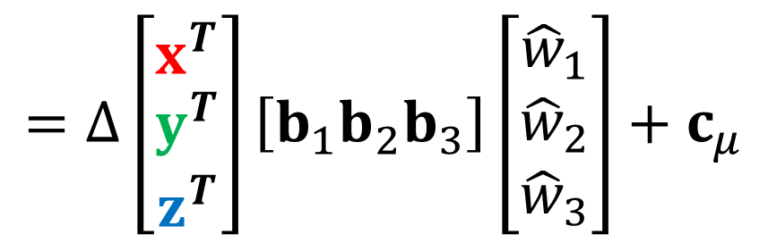
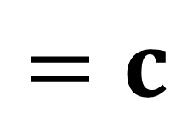
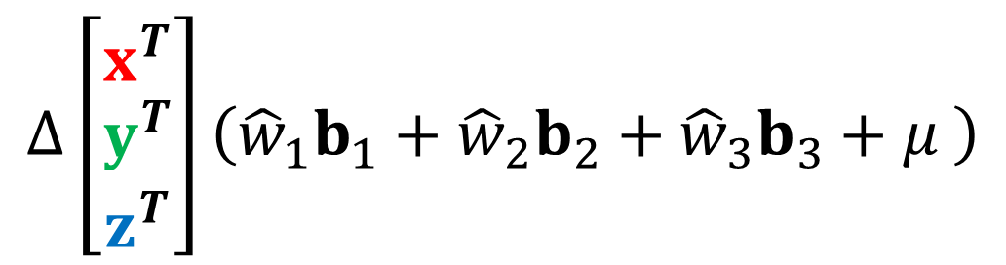
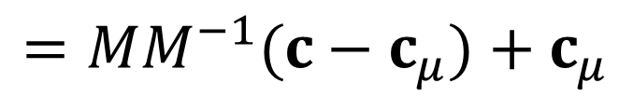
Reconstruction via PCA
Reconstructed spectrum can be converted back to input color
$$Δ\left[\begin{matrix}x^{T} \\ y^{T} \\ z^{T}\end{matrix}\right]\left({\hat{w}}_{1}b_{1}+{\hat{w}}_{2}b_{2}+{\hat{w}}_{3}b_{3}+μ \right)$$
Reconstructed spectrum
$$=Δ\left[\begin{matrix}x^{T} \\ y^{T} \\ z^{T}\end{matrix}\right]\left[b_{1}b_{2}b_{3}\right]\left[\begin{matrix}{\hat{w}}_{1} \\ {\hat{w}}_{2} \\ {\hat{w}}_{3}\end{matrix}\right]+c_{μ}$$
$$=c$$
$$=MM^{−1}(c−c_{μ})+c_{μ}$$
Input color
Notes:
We note that, the spectrum reconstructed by the weights can convert back to the original tristimulus color. Again, this property is important in rendering, because the final color of the pixel eventually needs to be converted from the spectrum.

Slide 27
Hierarchical chromatic clustering
Recovering shapes of spectra is not sufficient with a single set of basis
Blue: PCA only, Red: w/ clustering: Dotted: Original spectra
Notes:
Since we limit the number of basis functions to three, there is a case that one set of basis functions cannot fully reconstruct the shape of the spectra.

Slide 28
Hierarchical chromatic clustering
Idea: Cluster tristimulus color space to minimize reconstruction errors (diff. of spectrum shapes)
Uses xy in xyY color space for clustering
Notes:
We then proposed the hierarchical clustering technique in order to minimize the reconstruction error. The idea is to separate the tristimulus color spaces into several clusters in xy coordinates of xyY color space, and assign a set of basis functions to each cluster.

Slide 29
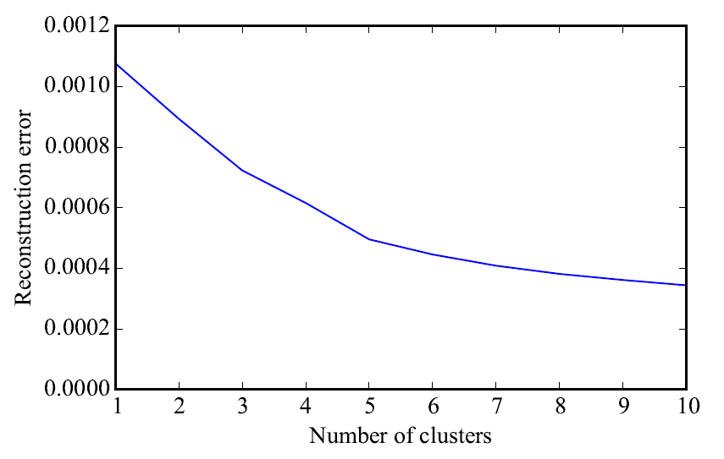
Hierarchical chromatic clustering
Greedy, top-down construction
Similar to construction of BVH
Determines splitting position along with x or y axis so that the sum of reconstruction errors is minimized.
Notes:
The construction processes proceeds top-down manner, similar to the construction of BVH, by iteratively splits a set of measured spectra.
For each step, we determine the split position along with x or y axis so that the sum of the reconstruction errors of the separated sets is minimized.

Slide 30
Notes:
As a result, we can cluster the spectra with similar tendency of the shapes.

Slide 31
Notes:
As a result, we can cluster the spectra with similar tendency of the shapes.

Slide 32
Notes:
As a result, we can cluster the spectra with similar tendency of the shapes.

Slide 33
Result
Datasets: Measured data of matte Munsell color chips [Kohonen et al. 2006]
I: 1269 measurements in [380, 800] nm w/ 1nm interval
II: 1250 measurements in [400, 700] nm w/ 5nm interval
RGB color space: sRGB under D64 illuminant
Compared methods:
Smits [Smits 1999]
Meng et al. [Meng et al. 2015]
Ours: Proposed method
Notes:
Let’s move on to the results.
We used two dataset of the measured spectra of matt Munsell color chips. As a RGB color space for the visualization and rendering, we used sRGB color space with D64 illuminant. In the experiments, we compared our approach with the approaches by Smits and Meng et al.

Slide 34
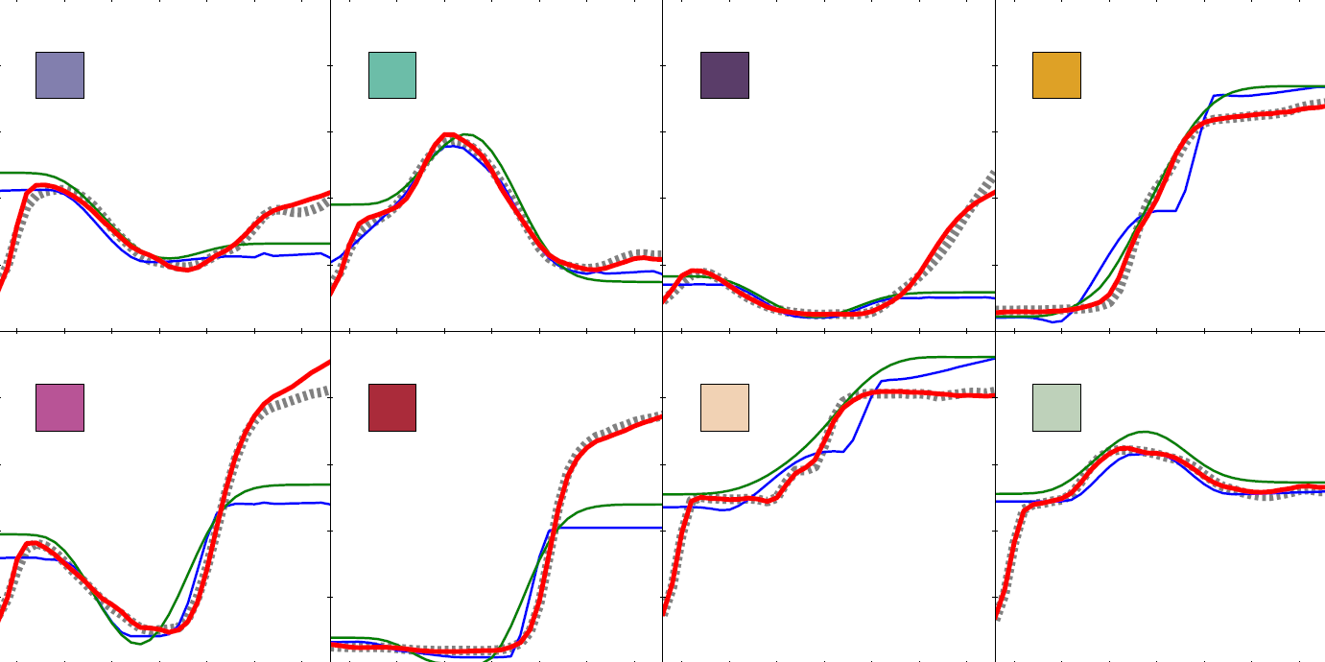
Blue: Smits, Green: Meng et al., Red: Ours, Dotted: Reference
Notes:
This figure illustrates reconstructed spectra from the same tristimulus color, obtained from the reference spectrum. Dot lines are reference spectra. And blue, green, and red lines are reconstructed spectra respectively using the approaches by Smits, Meng et al, and ours.
[click]
We can observe that the reconstructed spectra with our approach match well with the measured spectra in many cases.

Slide 35
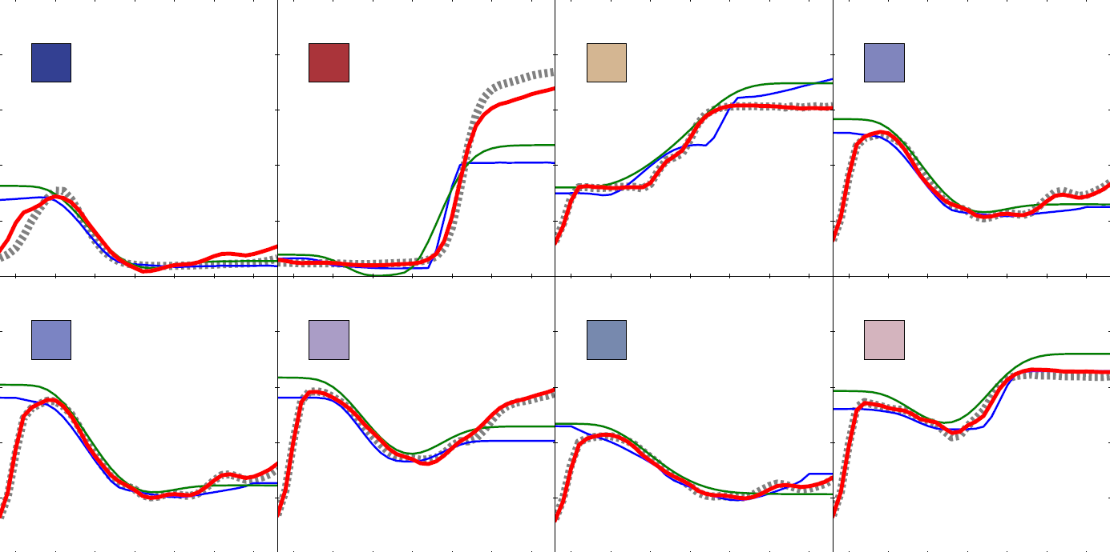
Blue: Smits, Green: Meng et al., Red: Ours, Dotted: Reference
Notes:
This figure illustrates reconstructed spectra from the same tristimulus color, obtained from the reference spectrum. Dot lines are reference spectra. And blue, green, and red lines are reconstructed spectra respectively using the approaches by Smits, Meng et al, and ours.
[click]
We can observe that the reconstructed spectra with our approach match well with the measured spectra in many cases.

Slide 36
Reconstruction error
Method | Mean error | Median error | Max error
Smits | 0.1904 | 0.0819 | 1.8439
Meng et al. | 0.1633 | 0.0710 | 1.1410
Ours | 0.0138 | 0.0053 | 0.9875
Reconstruction for dataset I
Notes:
The table shows L2 reconstruction errors for each reconstruction method. We can observe our approach outperforms the other methods [click] in both datasets.

Slide 37
Reconstruction error
Method | Mean error | Median error | Max error
Smits | 0.1297 | 0.0633 | 1.1825
Meng et al. | 0.1566 | 0.0985 | 1.0305
Ours | 0.0022 | 0.0012 | 0.0220
Reconstruction for dataset II
Notes:
The table shows L2 reconstruction errors for each reconstruction method. We can observe our approach outperforms the other methods [click] in both datasets.

Slide 38
Smits
Notes:
Next we rendered images with spectral rendering using the reconstructed spectra. The scene is composed of diffuse surfaces, and illuminated by several light sources, including those behind the object in the chairs. All illuminants are black-body illuminants of 5500K.
This is a result with the approach by Smits.

Slide 39
Error: 0.2625
1.0
0.0
Smits
Notes:
… and a visualization of the relative RMSE. We can observe that the error is large where the interreflection can often happen.

Slide 40
Meng et al.
Notes:
This is a result with the approach by Meng et al.

Slide 41
Error: 0.3021
1.0
0.0
Meng et al.
Notes:
… and its errors.

Slide 42
Ours
Notes:
On the other hand, the result with our approach,

Slide 43
Error: 0.1199
1.0
0.0
Ours
Notes:
can reduce the reconstruction errors because the spectrum can be reconstructed with similar shape to the measured spectrum.

Slide 44

Smits
Notes:
This is the comparison with the different scenes. Again, the scene is mainly composed of the diffuse materials, and illuminated with multiple light sources. The light sources behind the sofa creates significant interreflections.

Slide 45
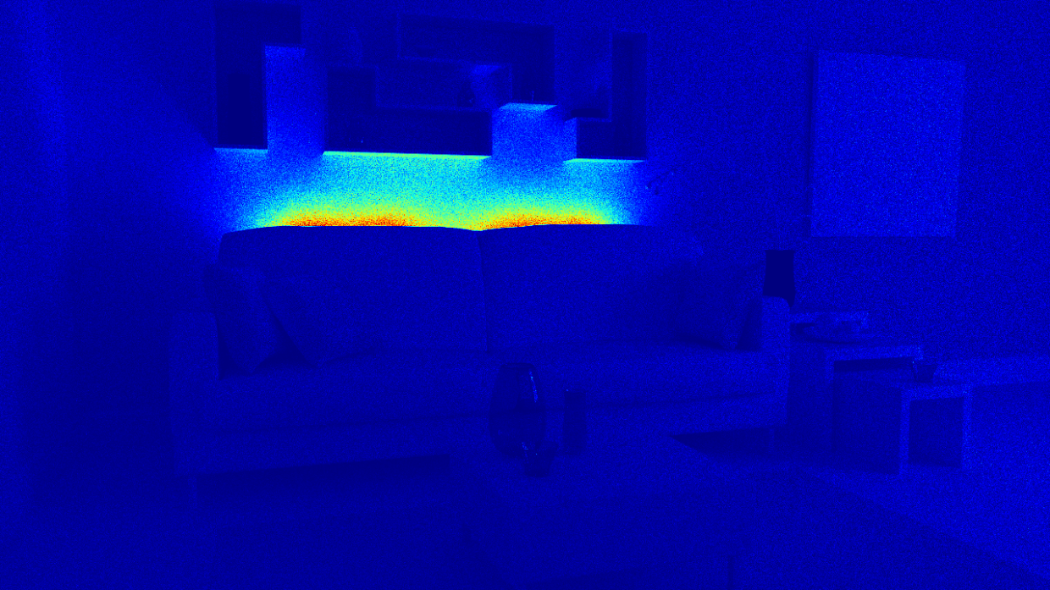
Error: 0.3082
0.2
0.0
Smits
Notes:
Similar to the previous scene, we can observe that the error is large in the part of the scene where the interreflection happens a lot.

Slide 46

Meng et al.
Notes:
The approaches by Meng et al. …

Slide 47
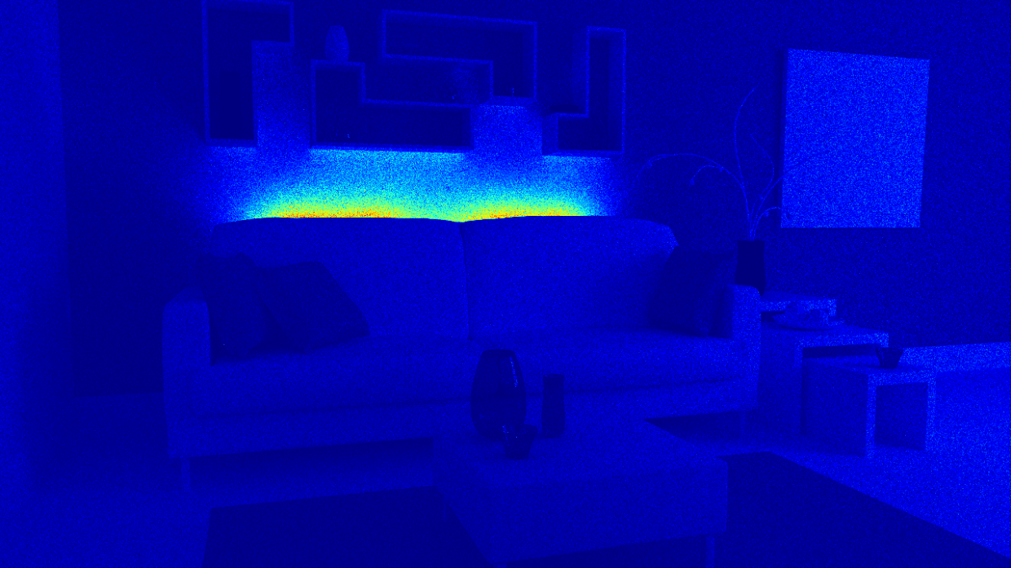
Error: 0.2718
0.2
0.0
Meng et al.
Notes:
… shows similar tendency.

Slide 48
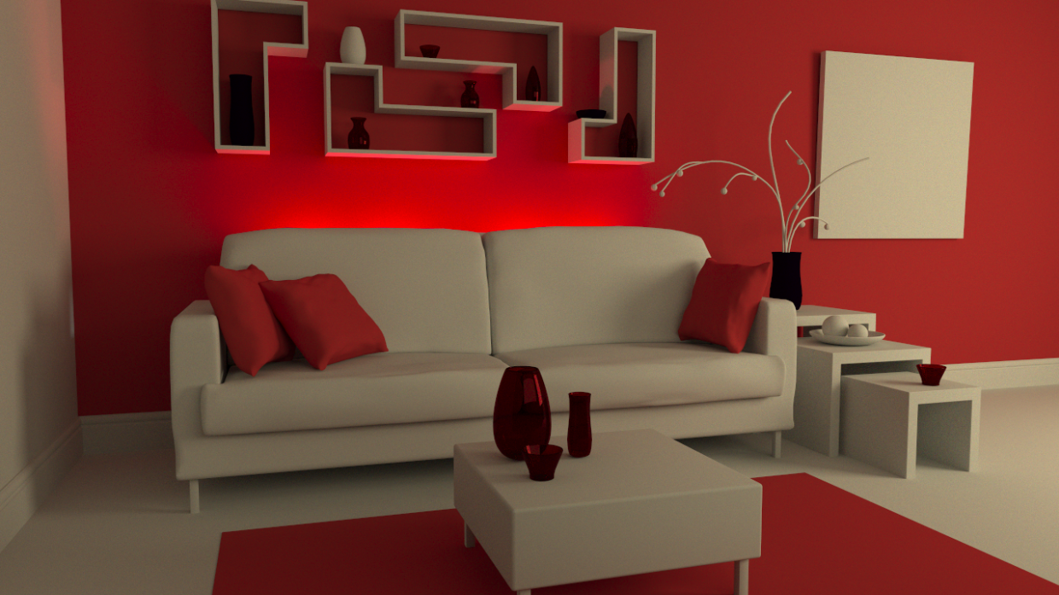
Ours
Notes:
On the other hand, the proposed approach ..

Slide 49
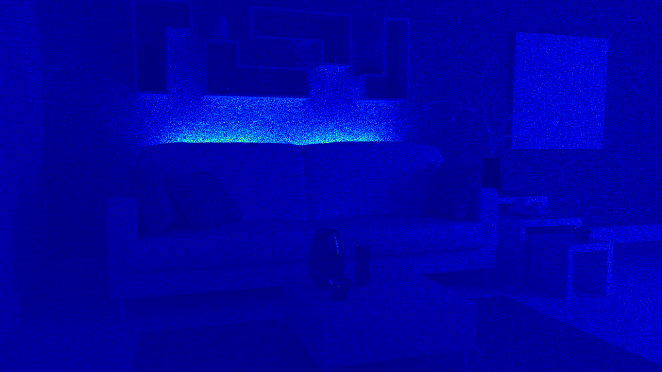
Error: 0.1532
0.2
0.0
Ours
Notes:
… can again reduce the reconstruction errors.

Slide 50
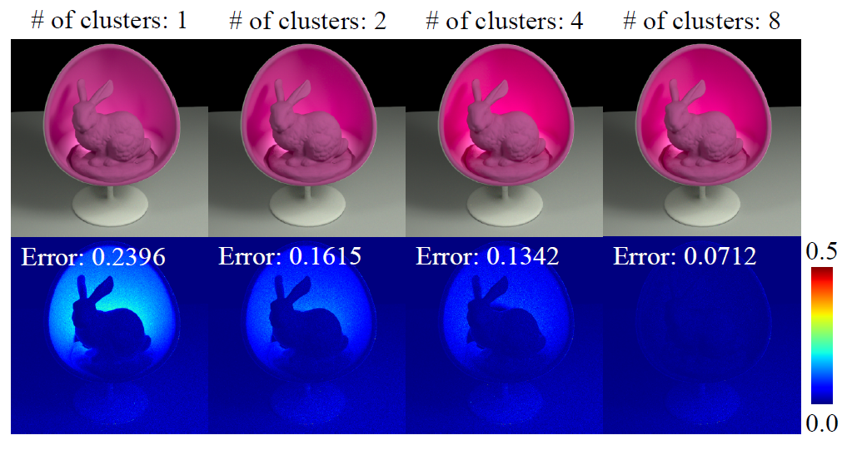
Notes:
This figure shows the effect of number of clusters to the reconstruction errors. We can see that, as the number of clusters increases, the reconstruction error becomes smaller.

Slide 51
Discussion
Difference with “direct-PCA”
Direct-PCA can reconstruct the shape, but does not recover the tristimulus values converted from the reconstructed spectrum.
Contribution given the related work in color science [Ayala et al. 2006, Zhang & Xu 2008]
They also uses PCA to reconstruct a spectrum from tristimulus values, although they did not use clustering scheme to minimize the reconstruction error.
Our approach is initial data-driven approach in graphics field.
Notes:
Move onto the discussion.
First, about the difference between the reconstruction with directly applying PCA. Although it can reproduce the shape of the spectrum accurately, the approach generally does not recover the original tristimulus colors from the reconstructed spectrum. It does not meet our requirement.
Next, we note that the difference between the similar approaches in color science field. Our approach is different because we use hierarchical clustering to minimize the reconstruction errors. Also, our approach is initial application of data-driven reconstruction scheme in the graphics field.

Slide 52
Discussion
Data compression vs. learning
We focus on a compact representation of the spectrum based on the specific data, and does not focus on the reconstruction of the general spectrum.
Thus we evaluated the approaches only with the precomputed data obtained from the same dataset
Notes:
Also, the evaluation of the approaches is done with the precomputed data obtained from the same dataset. This is because we focus on a compact representation of the spectrum based on the specific data, rather than the general spectrum.

Slide 53
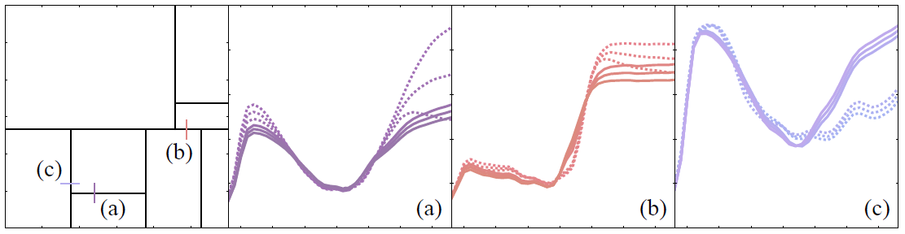
Limitation
Reconstruction in cluster boundaries
Notes:
I will discuss on the limitations.
This figure illustrates the change of the reconstructed spectra in the cluster boundaries. The bold and dotted lines show the reconstructed spectra in different clusters. Since our reconstruction algorithm does not explicitly consider the continuity across the boundaries, we found that the shape of the spectra do not necessarily changes smoothly.
In the figure, the case with (a) and (b) shows relatively smooth change, yet the case of (c ) shows some discontinuity of the shapes in different clusters.

Slide 54
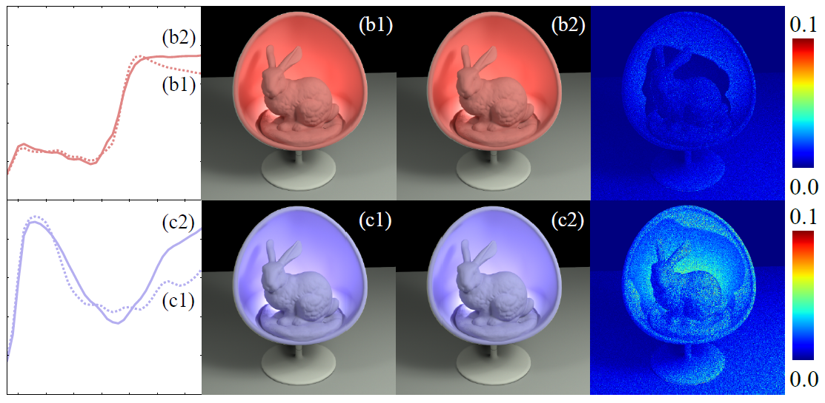
Notes:
Even in that case, the visual difference is small but still noticeable in the difference image.

Slide 55
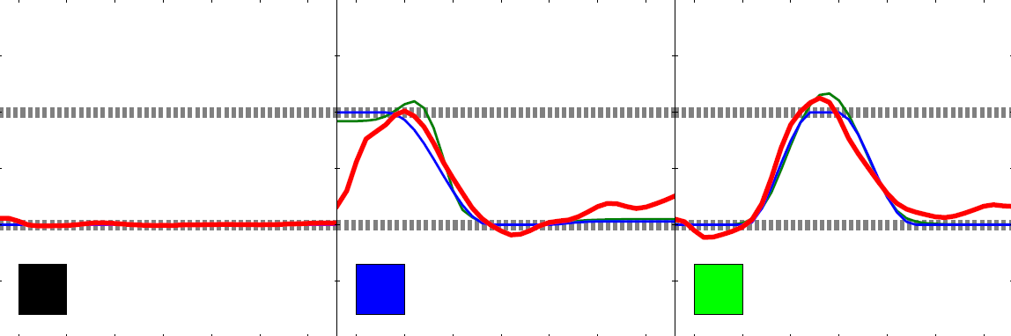
Limitation
Resulting spectral reflectances must be in the range of [0,1] for every wavelength
In this case, clamping is needed but the clamped spectra might not convert back to the original color
Notes:
The next limitation is, the reconstructed spectrum might not within the range of valid reflectance spectrum. We thus need to clamp the part of the spectrum outside of the range. Due to this process, the reconstructed spectrum does not always recover back to the original tristimulus color.

Slide 56
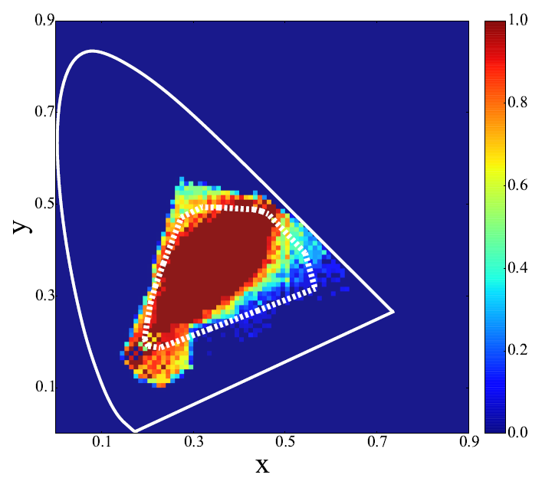
Limitation
Ratio of reconstructed spectra within the valid [0,1] range of the reflectance
Region enclosed by dotted line: Gamut of original measured data
Notes:
This figure shows the ratio of the reconstructed spectra within the valid range of the reflectance. The reconstruction near the original data reconstructs fine, but outside that gamut, the deviation gets larger and thus we need clamping.

Slide 57
Conclusion
Data-driven reconstruction of spectral reflectance from tristimulus colors
Reproduce spectral reflectance from tristimulus colors using knowledge of measured spectra
Hierarchical clustering technique to minimize reconstruction errors
Notes:
Conclusion.
We presented an data-driven approach to reconstruct spectral reflectance from tristimulus colors. We represented a spectrum with lower-dimensional representation obtained from the measured data using PCA, and reconstruct the spectrum from a tristimulus color. Also, we proposed a hierarchical clustering technique to reduce the reconstruction error.
This is the end of my talk. Thank you.

Slide 59
Supplemental slides

Slide 60
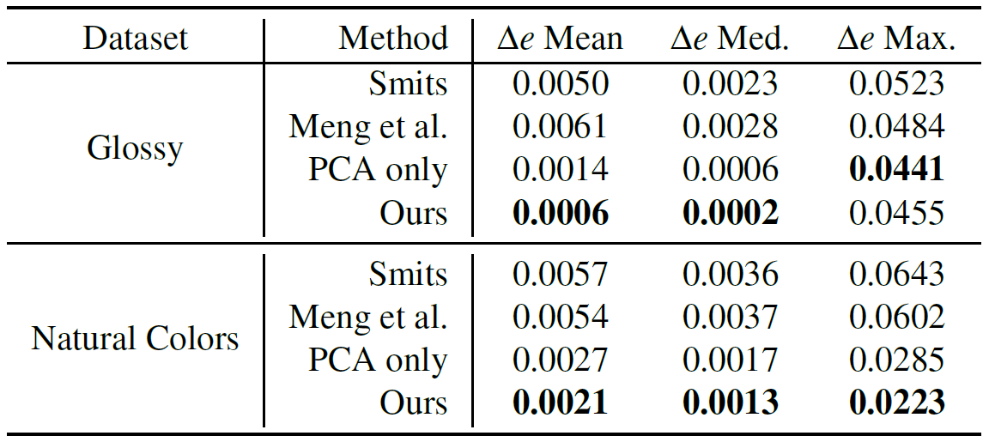
Reconstruction error for additional datasets

Slide 61
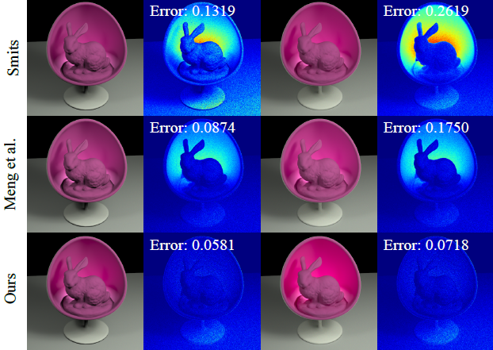
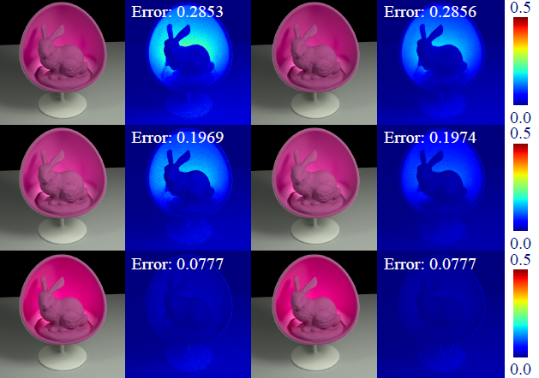
Error vs. # of bounces
Bounces 2
Bounces 6
Bounces 14
Bounces 18

